Slide 1
  On a Rainy Night
  //On a rainy night I will arrive chilly and cold//
  //If your mama senses something tell her it is the dog.//
  //Wake me up and send me home when the speckled rooster crows//
  //And Monday morning when you meet me ask me for a little bread//
  //If your brothers should get angry please just look at them with laughter//
  //When the priest calls you just tell him the same thing//
  //And when the nine months are up go hide deep in the forest.//
  //I will be loving you from here intensely.//

Slide 2
  //Tamia tuta shamushami chiri chiri paktamusha//
  //Kamba mama riparakpi allkumi nisha rimangui//
  //muru gallu katanshkaybi likchachisha chachawangui//
  //lunes punzha tupashaga tandawallas mañawangui//
  //turiguna pinãnujpi asishalla riku-pa-ngui//
  //yayapairi kayachikpi shinallara rimapangui//
  //iskun killa paktariukpi shacha ukuma mitikungui//
  //kaymandaga llakiushami wañushalla sakishkangui//
  //iskun killa paktariukpi sacha ukuma mitikungui//
  //kaymandaga llakiushami wañushalla sakishkangui//

Slide 3
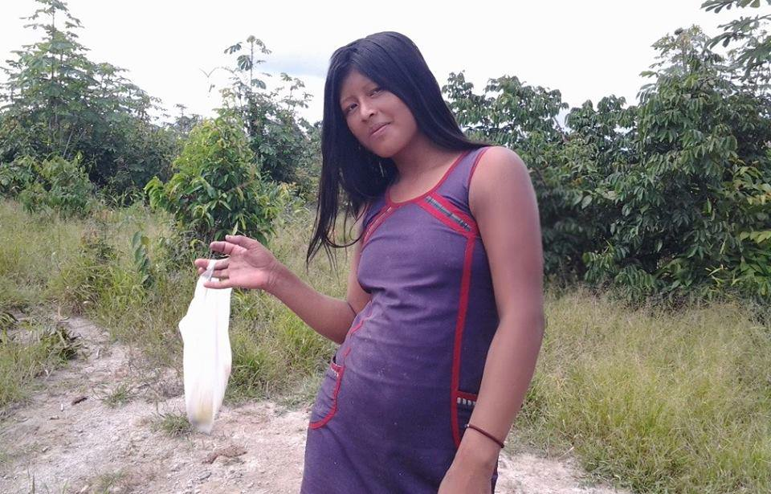
  Tamia tuta shamu-shami chiri chiri paktamu-sha

Slide 4
  Tamia tuta shamushami chiri chiri paktamusha
  //On a rainy night I will arrive chilly and cold//

Slide 5
  Tamia tuta shamushami chiri chiri paktamusha
  //On a rainy night I will arrive chilly and cold//

Slide 6
  //Kamba mama ripara-kpi allku-mi nisha rimangui//

Slide 7
  //If your mama senses something tell her it is the dog.//
  //Kamba mama riparakpi allkumi nisha rimangui//

Slide 8
  //muru gallu katashkaybi likchachi-sha kacha-wa-ngui//

Slide 9
  //Wake me up and send me home when the speckled rooster crows
  //muru gallu katashkaybi likchachisha kachawangui//

Slide 10
  //lunes punzha tupa-sha-ga tanda-wa-llas maña-wa-ngui//

Slide 11
  //And Monday morning when you meet me ask me for a little bread//
  //lunes punzha tupashaga tandawallas mañawangui//

Slide 12
  //turiguna pinãnu-kpi asishalla riku-pa-ngui//

Slide 13
  //turiguna pinãnukpi asishalla rikupangui//
  //If your brothers should get angry please just look at them with laughter

Slide 14
  //yayapairi kaya-chi-jpi shina-llara rimapangui//

Slide 15
  //And if father priest should call you just tell him the same thing//
  //yayapairi kayachijpi shinallara rimapangui//

Slide 16
  //iskun killa paktariukpi sacha ukuma mitikungui//

Slide 17
  //Then when the nine months are up go hide deep in the forest
  //iskun killa paktariukpi shacha ukuma mitikungui//

Slide 18
  //kay-manda-ga llakiushami wañushalla sakishkangui//

Slide 19
  //kaimandaga llakiushami wañushalla sakishkangui//
  //From here I will be just be loving you intensely//

Slide 20
  Spare text. Uses few words to get to the core of human relations.
  List the relations in which distance is created.
  Once this love happens who will not be able to talk to whom?

