Slide 1
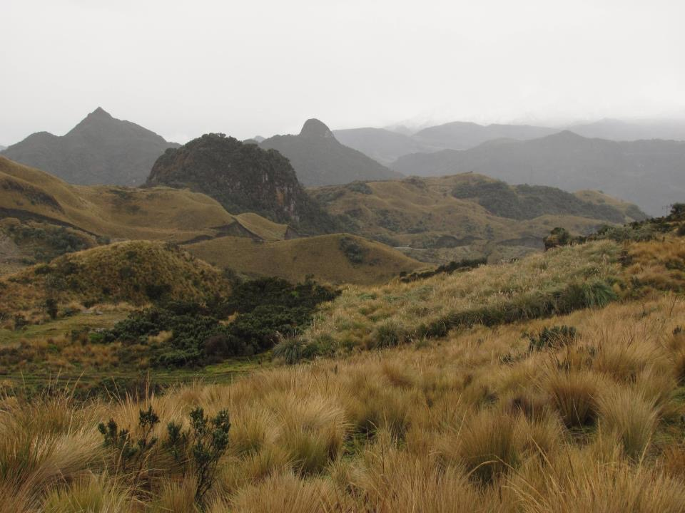
What do the religions of the Americas have in common? How are they different from the monotheistic religions of the Middle East and Europe?
Even though there are hundreds of different indigenous language traditions in the Americas here are some of the things which I think they have in common and which distinguish them from the the monotheistic traditions.
1. Native religions in the Americas are focussed on a relationship to the local land rather than on a relationship to a God beyond this world.

Slide 2
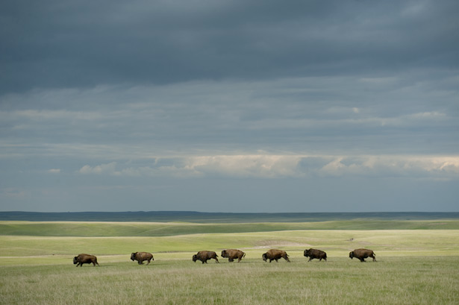
The relationship to the local land included all of its species, water, wind, mountains.

Slide 3
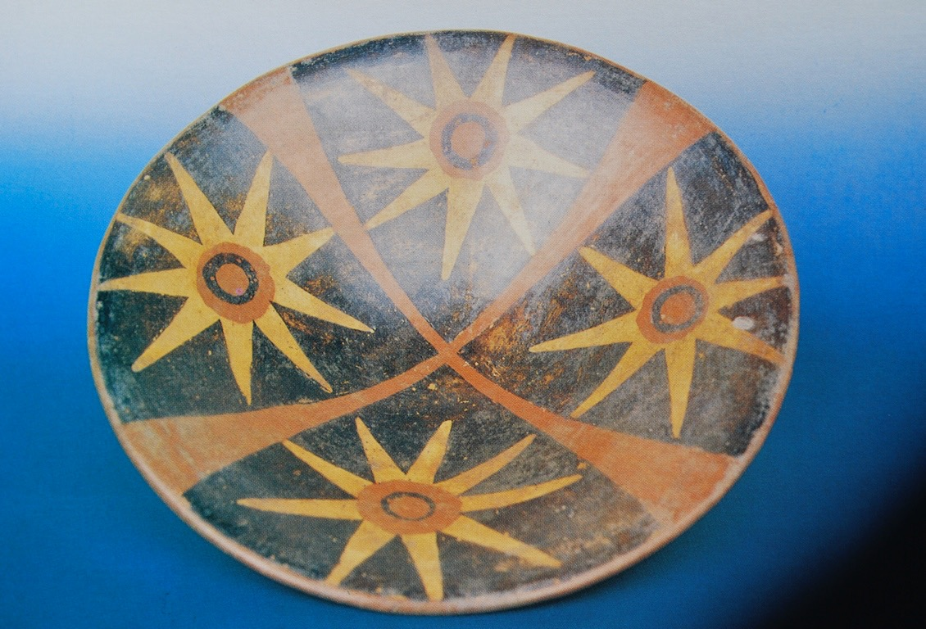
2. The native traditions posit a series of previous worlds culminating in this one.
Remembering the land, visiting the land, treating relatives well causes the land to endure. Forgetting the land, or treating it as though it were a mere thing, or treating relatives badly causes the land to age, wear out and die.
As a world ages the social relation to the earth and relatives is breaks down causing the world to end.
The origin stories tell how our present socially related and habitable world emerged from a preceding world which had become uninhabitable because social relations had broken down or were not yet present.
By contrast the monotheistic traditions posit a single world created by God out of nothing.
Inca era Quechua bowl showing the 4 quarter and 4 suns that indicate world ages.
The center of the bowl probably corresponds to the present.

Slide 4
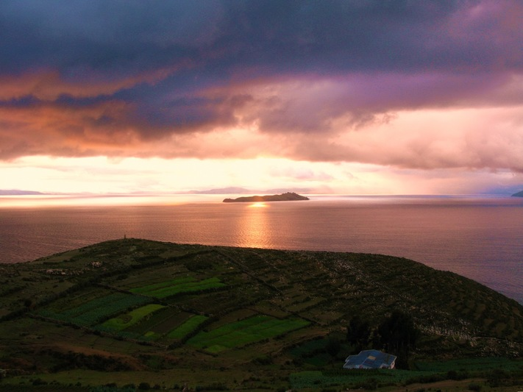
3. Each native tradition tells how their people emerged from the past world in a particular place and were given their particular land. Other groups emerged at other places and were similarly given a different land.
The traditions each particular group were given at the time of emergence for the purpose of living with that maintaining that local land.
Thus the traditions of one group of people are related to those of another ecologically like one echo niche is related to another.
Plains traditions are for living with the buffalo and for maintaining the plains environment while the traditions of the Sonoran desert are for living with the desert and maintaining the desert.
By contrast the monotheistic traditions (Christianity, Judaism and Islam) posit a universal divine law given for everyone for al time.
Lake Titicaca, an Andean emergence place.

Slide 5
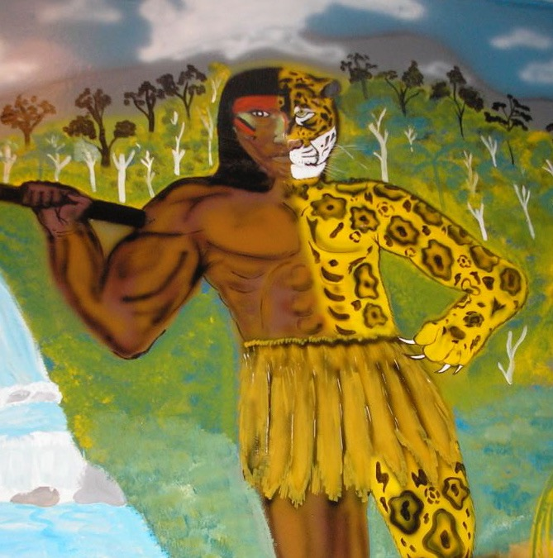
4. The plants, animals, and even the mountains are believed to have been human in the world before this one. At the time of emergence they were transformed into the species we see.

Slide 6
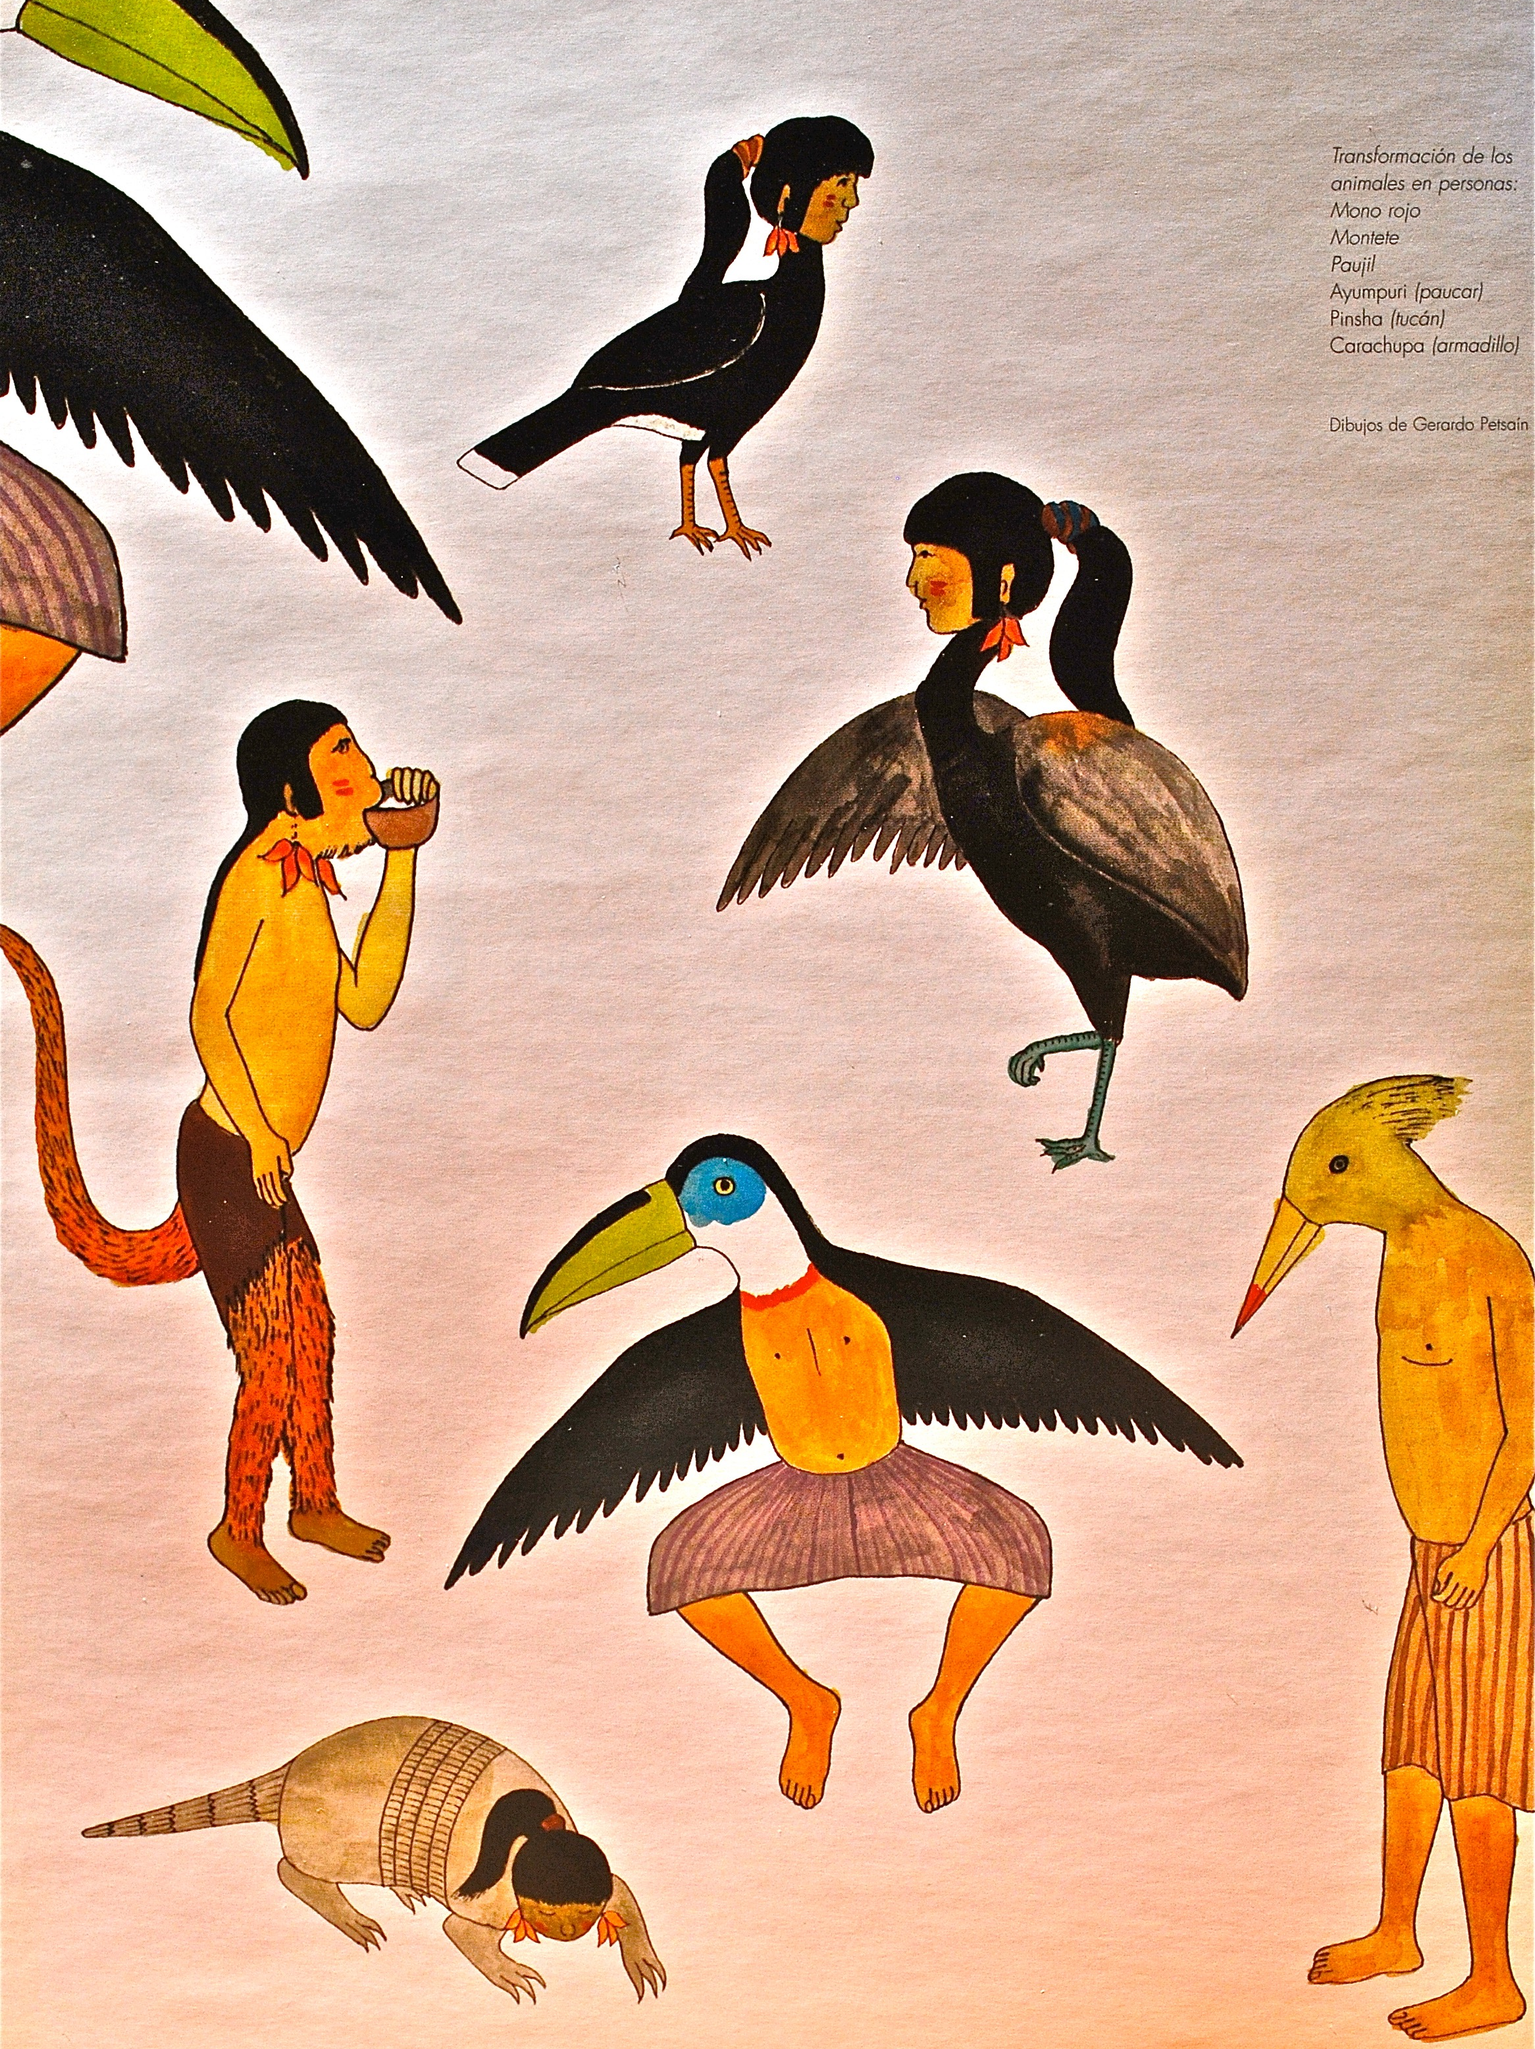
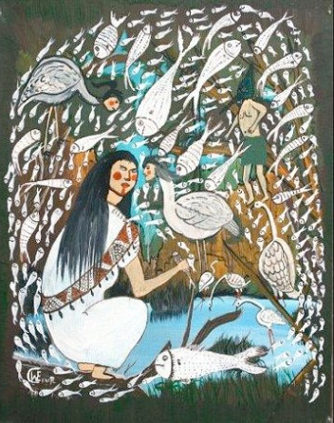
For this reason plants, animals, and land are understood to have cultural qualities comparable to our own. They have a sense of beauty, music, art, love and sorrow. They have their own language even though we cannot understand it.
By contrast in the monotheistic traditions only humans have culture because only they were made in the image of God

Slide 7
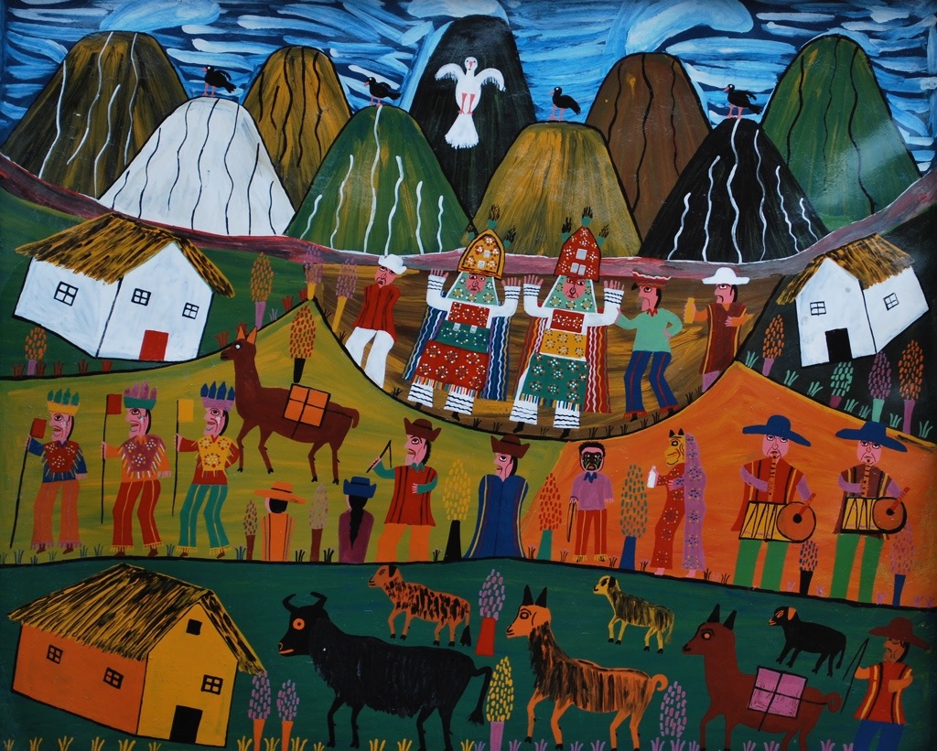
5. The relation to the land is a social relationship.
Because the the land and species are humanlike one should interact with the land socially, with respect, as though one were engaging a human relative. Like a human relative the land responds to attention and compliments, to beautiful singing, dancing, humor, to being visited and spoken to.
By contrast for the monotheistic traditions the land points to the creator but does not itself engage in social relations.

Slide 8
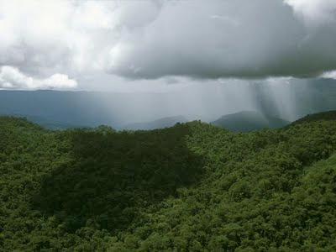
6. The land responds socially and emotionally to those who live on it.
When it responds with empathy it gives blessing in the form of health, abundant food, rain, success in school or business.
To those who are disrespectful land it can also withdraw these blessings resulting in illness, lack of rains, the withdrawal of animals and crops, and even failure in school or business.
For the monotheistic traditions it is only God and not the land who punishes or blesses.

Slide 9
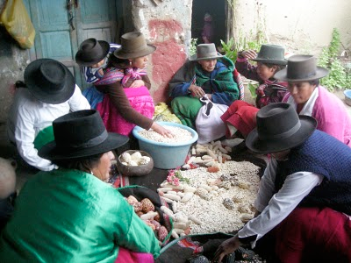
7. The subject or actor in the Native traditions is not an individual on their own but rather a person whose identity is a network of relatives. What ties this group of relatives together is the fact of having emerged together from the same land and having engaged the same land over time.
By contrast the actor is the morally responsible individual who can be save or damned on their own apart from the land or relatives.

Slide 10
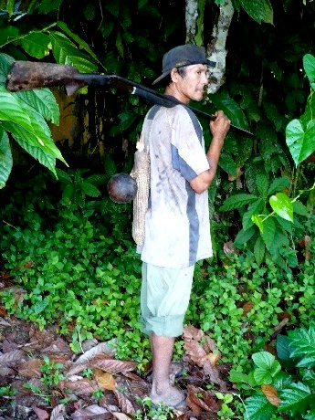
8. Shared food creates a bodily similarity to the land and relatives: An important part of the tie that binds a group of people to their land is eating the food from that land. Eating the local food, water and air is changes the composition of the body so that it becomes like the land including the smell and feel of the land.
So for example:
Plains people and bodies made of buffalo and plains food.
Tohono O’odham had Sonoran desert bodies made of cholla cactus, mesquite beans, saguaro fruit and desert foods.
Northwest coast people had bodies made of salmon and NW coast foods.
The activities used to acquire these foods further adapted the body to the particular land.
A lifetime of buffalo hunting adapted the bodies of plains men to be responsive to the plains.
A lifetime of gathering cactus or running to get salt adapted the bodies of Tohono O’odham to the Sonoran desert giving them Sonoran desert bodies.

Slide 11
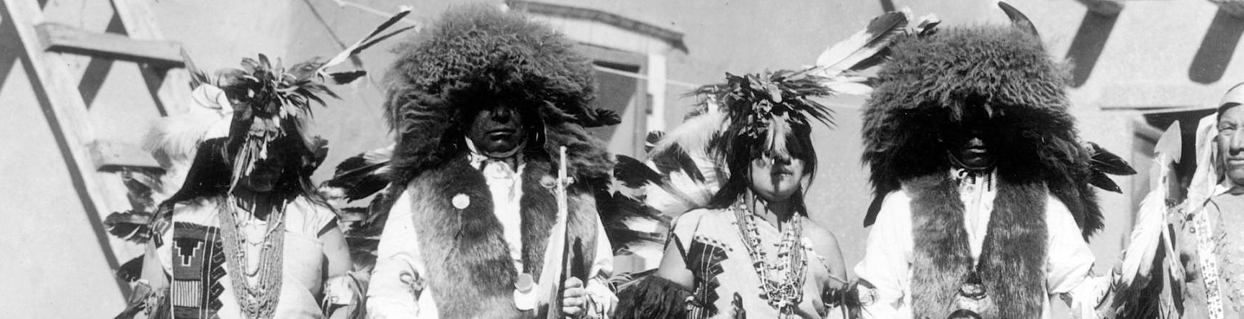
9. The bond of shared body was enhanced aesthetically by adorning the body with art, speech, songs, dance, songs and speech that evoked the land: and species.
Examples:
Facepaint patterns evoking species
Clothing embroidered with corn or made with the bones or feathers of local species.
The resemblance of bodily movement was enhanced through dance steps that matched the movements of local species.
The resemblance of the voice to the voices of the land was enhanced by onomatopoetic speech and song that matched the sound of birds and animals.
Personal names like “Black Elk” further tied identity to local species.
Through all of these things a group of relatives who lived in relation to the same land were believed to develop a bodily similarity to each other mediated by the similarity to the land. I call this physical similarity shared with each because shared with the same land “shared body”.
The similarity of this body increased emotional intimacy with the land.
The similarity of this shared body to the bodies of other relatives adapted to the same land also increased emotional closeness to these relatives.

Slide 12
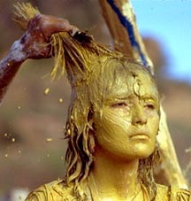
10. One of the key objectives of native ceremonies was to heighten this bodily similarity to the land and so make the relationship to the land more intimate leading to greater strength and blessings.
Example: Apache sunrise dance is intended to give strength to an Apache girl by changing her body through heightening her similarity to Changing Woman, and to her godmother and other mature Apache. In the process her body is adorned with corn pollen and oriole feathers.
Immediately after the ceremony her body is believed to have such increased strength that she isable to heal people by communicating some of this heightened bond with the land and her people to them.
Pictures and poem from Apache Sunrise dance
SUNRISE DANCE.(Poem)
The Midwest Quarterly | March 22, 2001 | McArthur, Mary |
Godmother massages my shoulders.
She is giving me Apache knowledge
of pale desert mornings,
of animals, and birds, and men.
Pinning a feather in my hair,
she calls me Fair Oriole.

